Slide 1

NETWORK
AND FIREWALL MANAGER
Inshaal Sheeraz- 2023260
Arham Khalid- 2023128
Ajwa Asghar- 2023092

Slide 2

Introduction to
the Project
Project Overview
The Network and Firewall Manager is a C++ program designed to simulate a network environment by managing devices, their connections, and data packet transmission
Objectives:
Efficiently simulate network devices and their connections.
Identify and manage corrupt and lost data packets.
Facilitate packet delivery in the network.

Slide 3

Features of the
project
Add Devices: Add devices to the network with unique IDs and names.
Create Connections: Establish connections between devices with simulated latency.
Generate Data Packets: Create packets with random error flags and destinations.
Error Handling: Identify corrupt packets and handle lost packets.
Display Graph: Visualize the network and its connections.

Slide 4

Technical
Overview
Programming Language: C++
Key Data Structures:
DataPacket: Represents the data being sent through the network.
Graph: Represents the network with devices and connections.
Neighbour: Represents connections with latency.
ErrorStack: Tracks corrupt and lost packets.

Slide 5

Project
Workflow
Adding Devices and Connections
Devices are added with unique IDs.
Connections are established with randomized latency.
2. Generating Packets
Packets are generated with random destinations and error flags.
3. Error Detection & Handling
Corrupt packets are pushed to the error stack.
Lost packets are identified when the destination is not found.
4. Packet Routing
Packets are delivered to the intended destination if no errors are detected.

Slide 6
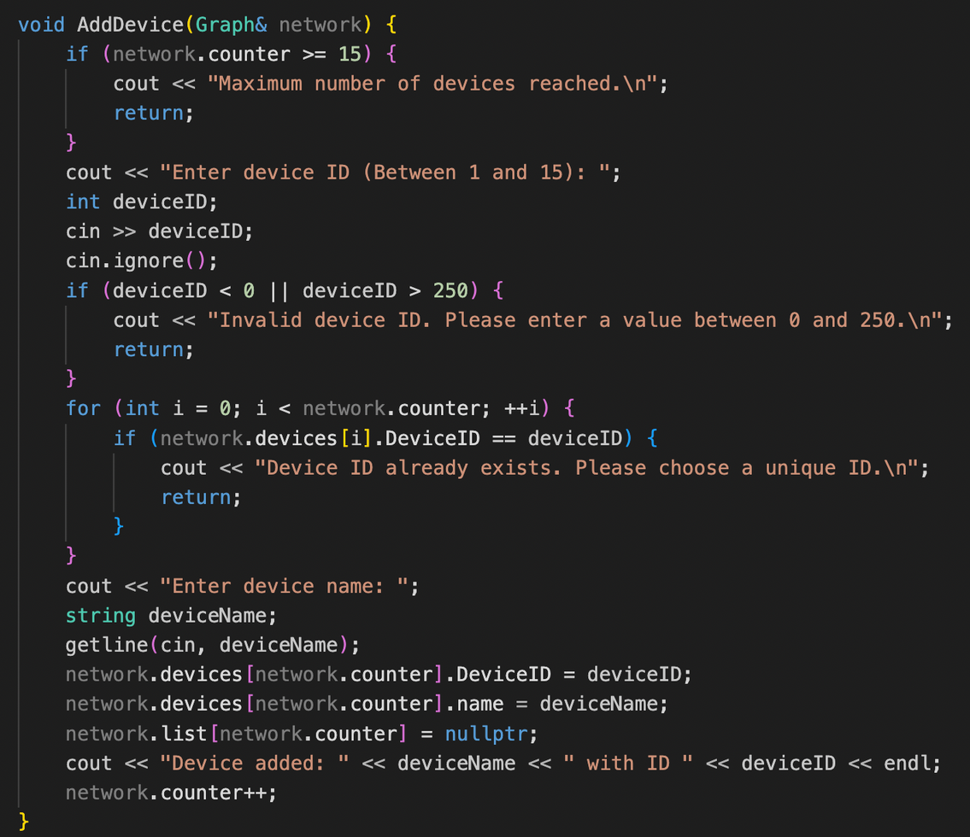
Code
Walkthrough
Focus on the key functions:
AddDevice: Adds a device to the network.
AddConnection: Establishes connections between devices.
GenerateDataPacket: Creates data packets.
CheckErrorFlags: Detects and handles corrupt packets.
ProcessPackets: Routes packets and handles lost packets.

Slide 7
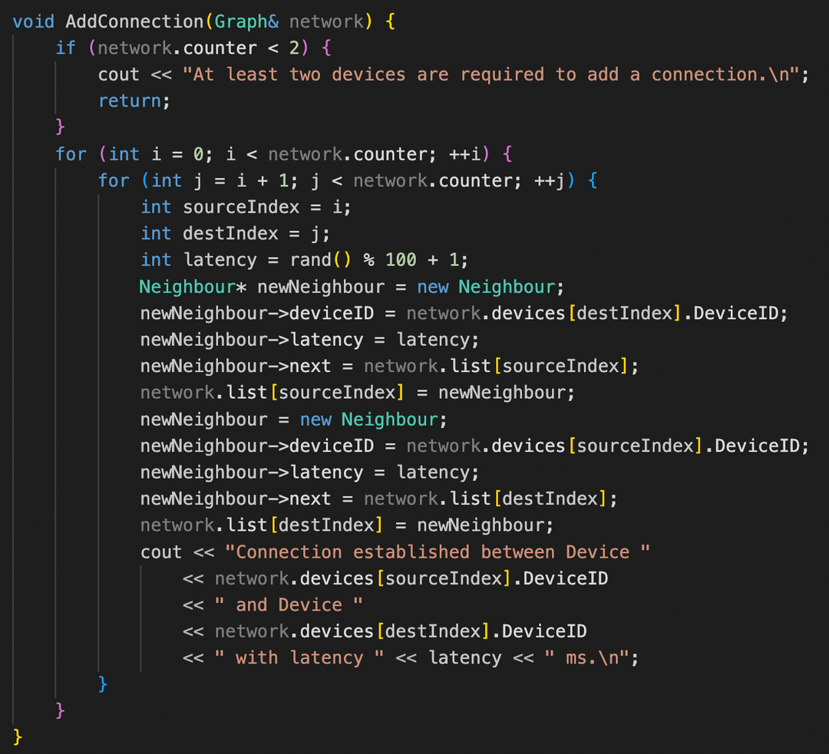
Code
Walkthrough
Focus on the key functions:
AddDevice: Adds a device to the network.
AddConnection: Establishes connections between devices.
GenerateDataPacket: Creates data packets.
CheckErrorFlags: Detects and handles corrupt packets.
ProcessPackets: Routes packets and handles lost packets.

Slide 8
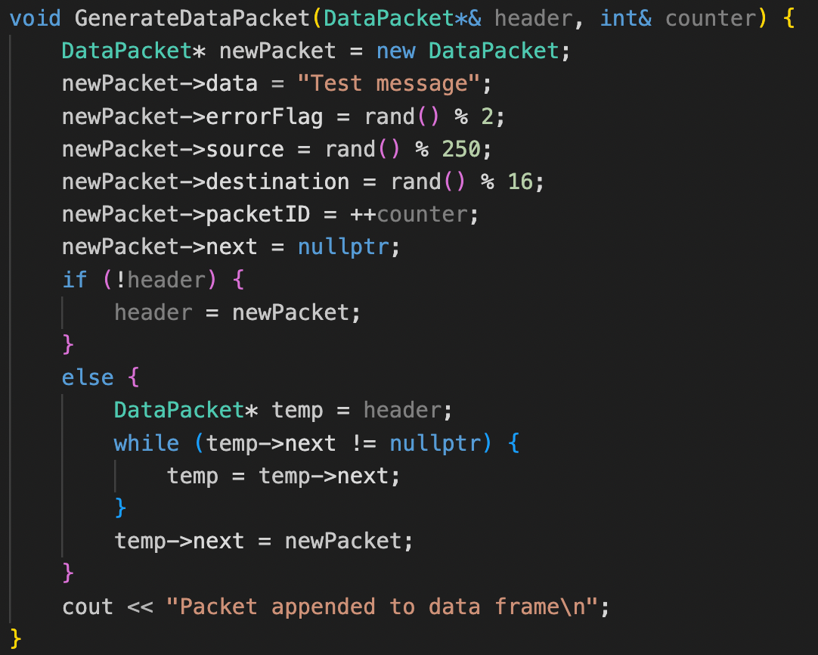
Code
Walkthrough
Focus on the key functions:
AddDevice: Adds a device to the network.
AddConnection: Establishes connections between devices.
GenerateDataPacket: Creates data packets.
CheckErrorFlags: Detects and handles corrupt packets.
ProcessPackets: Routes packets and handles lost packets.

Slide 9
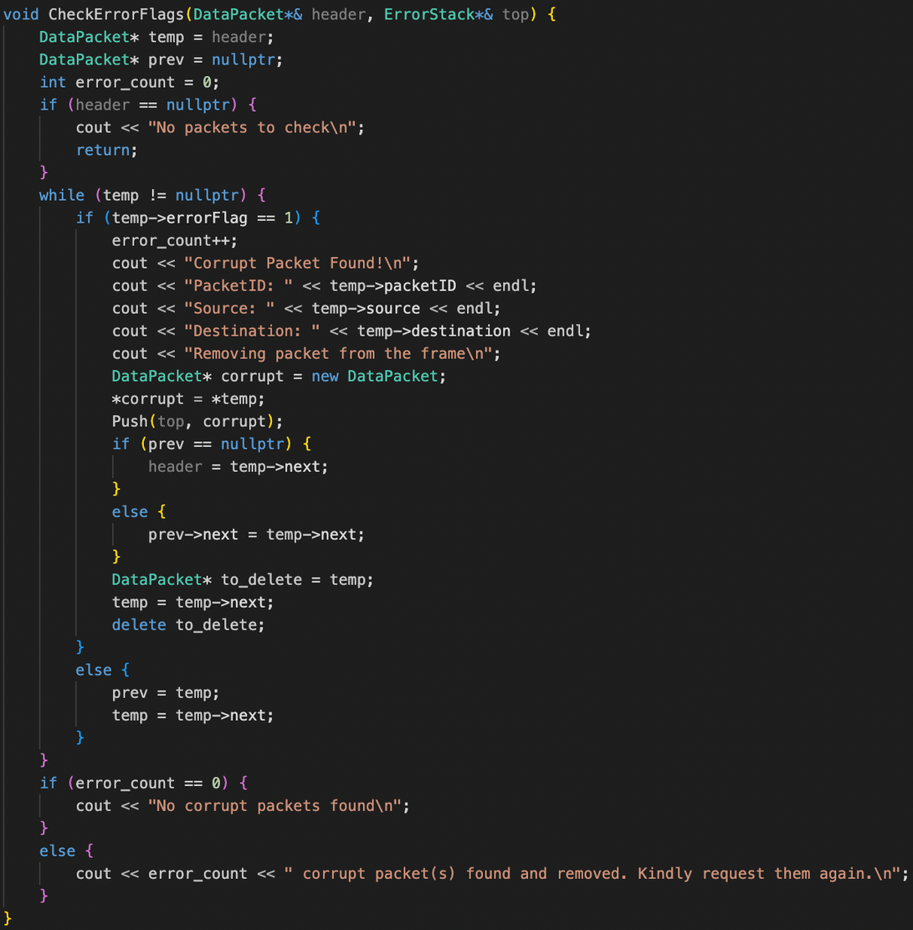
Code
Walkthrough
Focus on the key functions:
AddDevice: Adds a device to the network.
AddConnection: Establishes connections between devices.
GenerateDataPacket: Creates data packets.
CheckErrorFlags: Detects and handles corrupt packets.
ProcessPackets: Routes packets and handles lost packets.

Slide 10
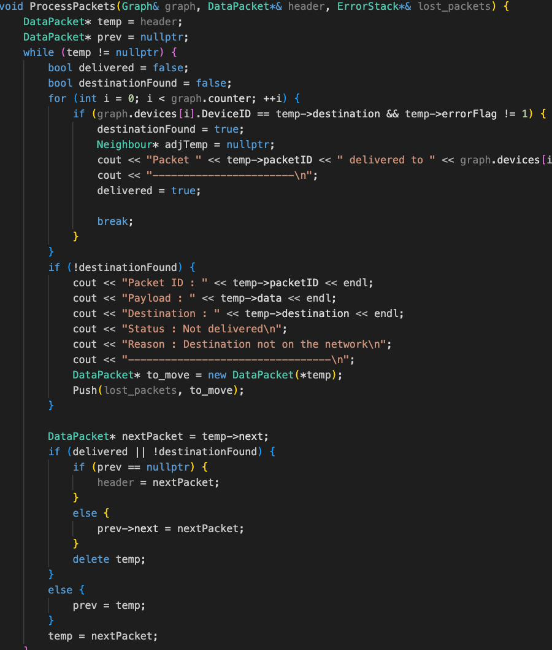
Code
Walkthrough
Focus on the key functions:
AddDevice: Adds a device to the network.
AddConnection: Establishes connections between devices.
GenerateDataPacket: Creates data packets.
CheckErrorFlags: Detects and handles corrupt packets.
ProcessPackets: Routes packets and handles lost packets.

Slide 11

Challenges
and Solutions
Challanges Faced:
Managing dynamic memory.
Implementing error detection and handling.
Maintaining clear network visualization.
Solutions:
Used proper data structures (e.g., linked lists).
Added error handling functions.
Clear console outputs for network visualization.

Slide 12

Conclusion
and Next Steps
Summary of Key Features:
Recap the primary functionalities of the project.
Future Enhancements:
Improve the graphical interface for better visualization.
Implement real-time network monitoring.
Add more robust error-correction mechanisms.
@reallygreatsite

Slide 13


